Slide 1
Chapter 1 Introduction

Slide 2
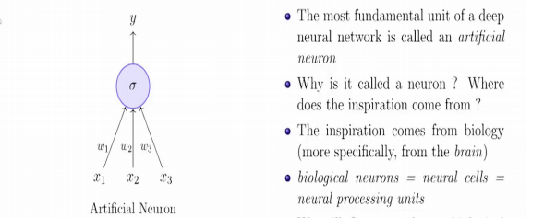
Neuron

Slide 3
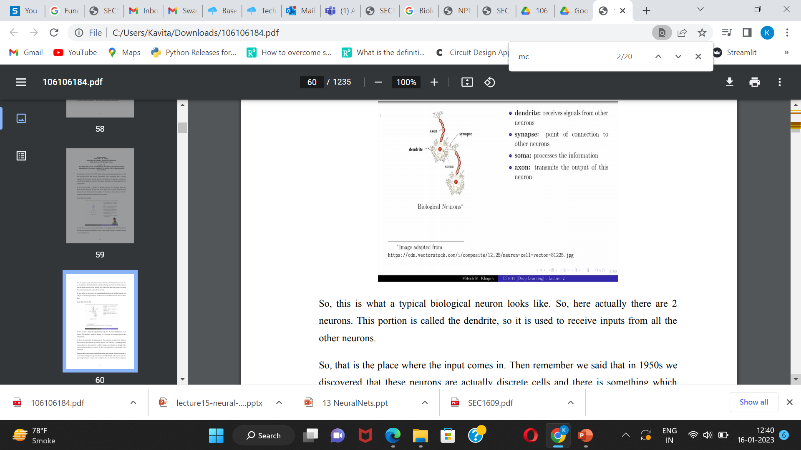
Neuron

Slide 4


Neuron

Slide 5
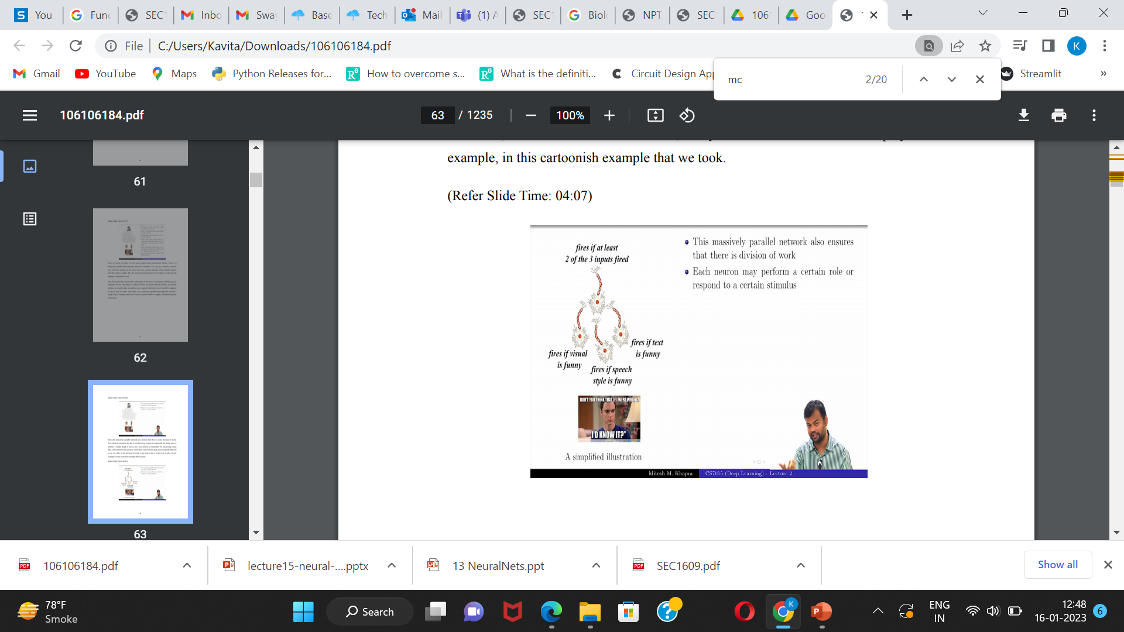
Neuron

Slide 6


Slide 7
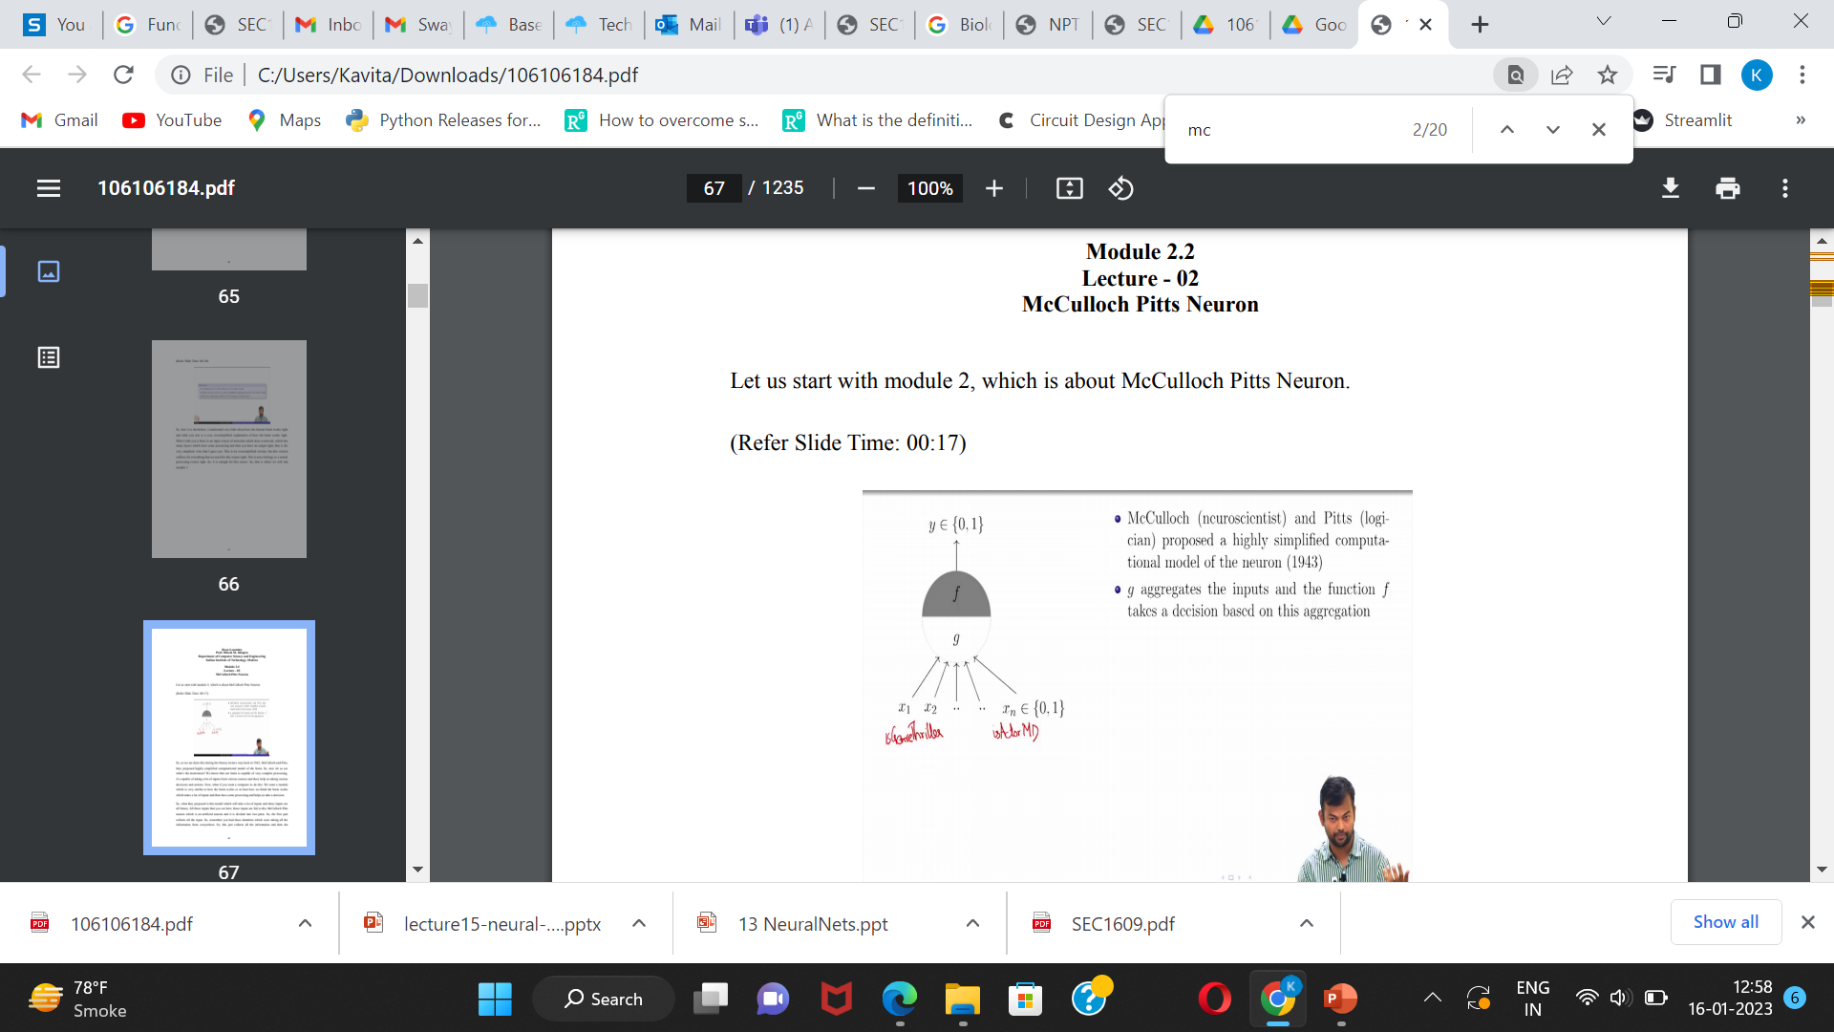
McCulloch Pitts Neuron

Slide 8
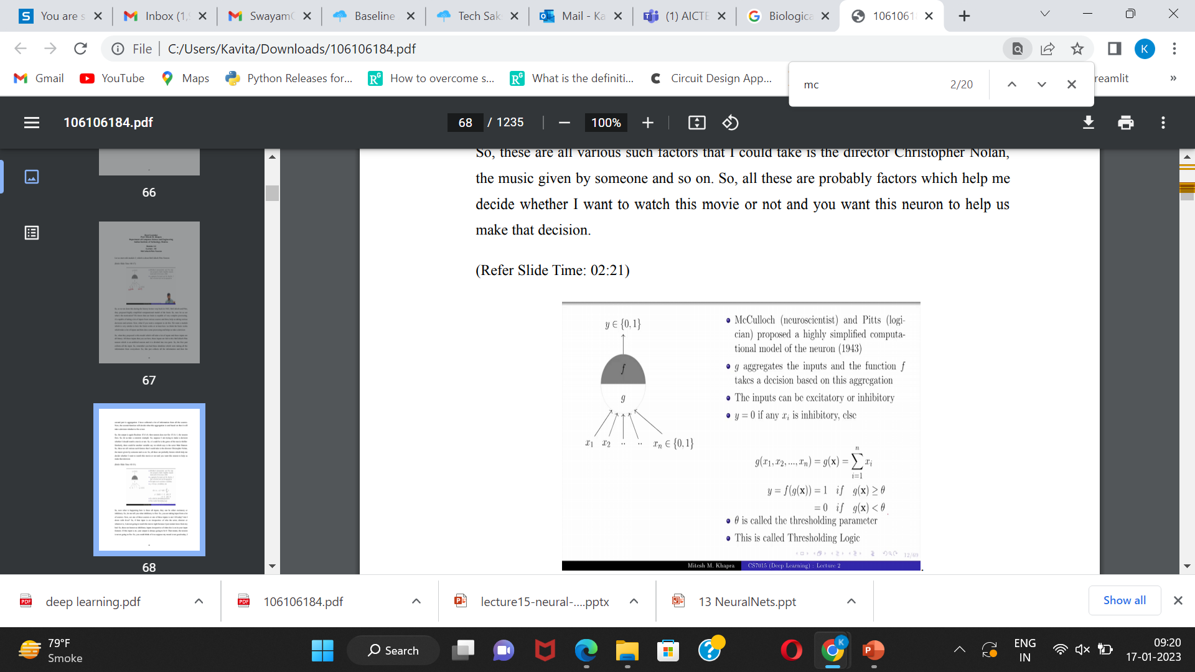
McCulloch Pitts Neuron

Slide 9
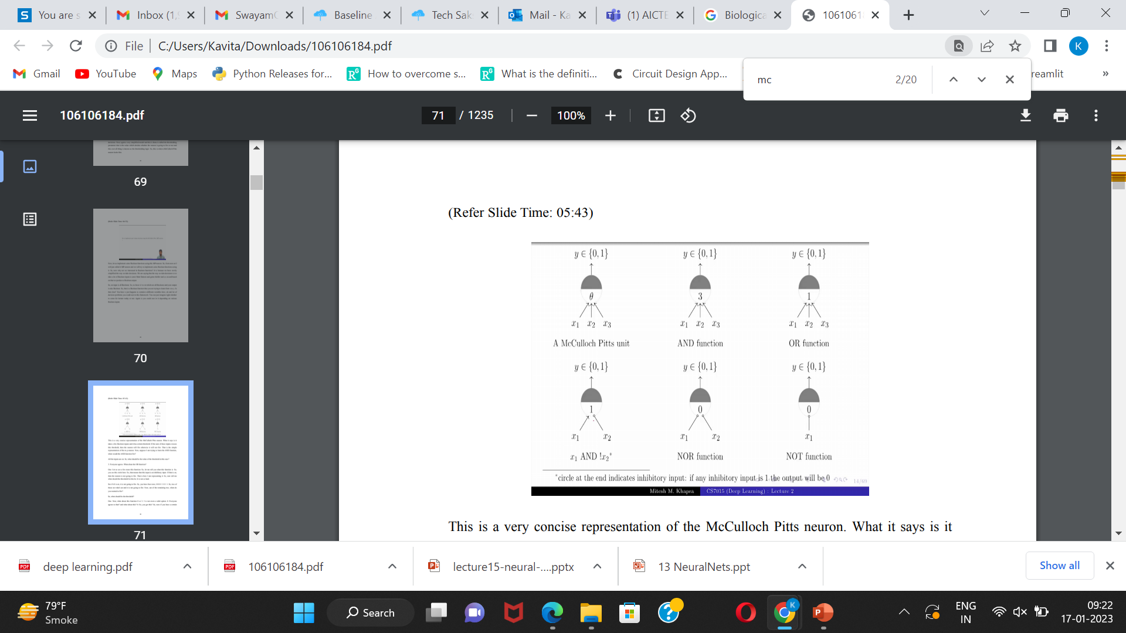
McCulloch Pitts Neuron

Slide 10
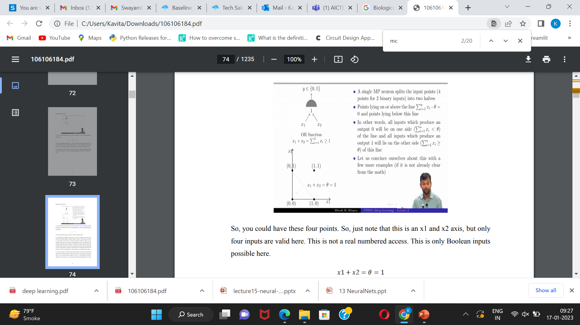

McCulloch Pitts Neuron

Slide 11
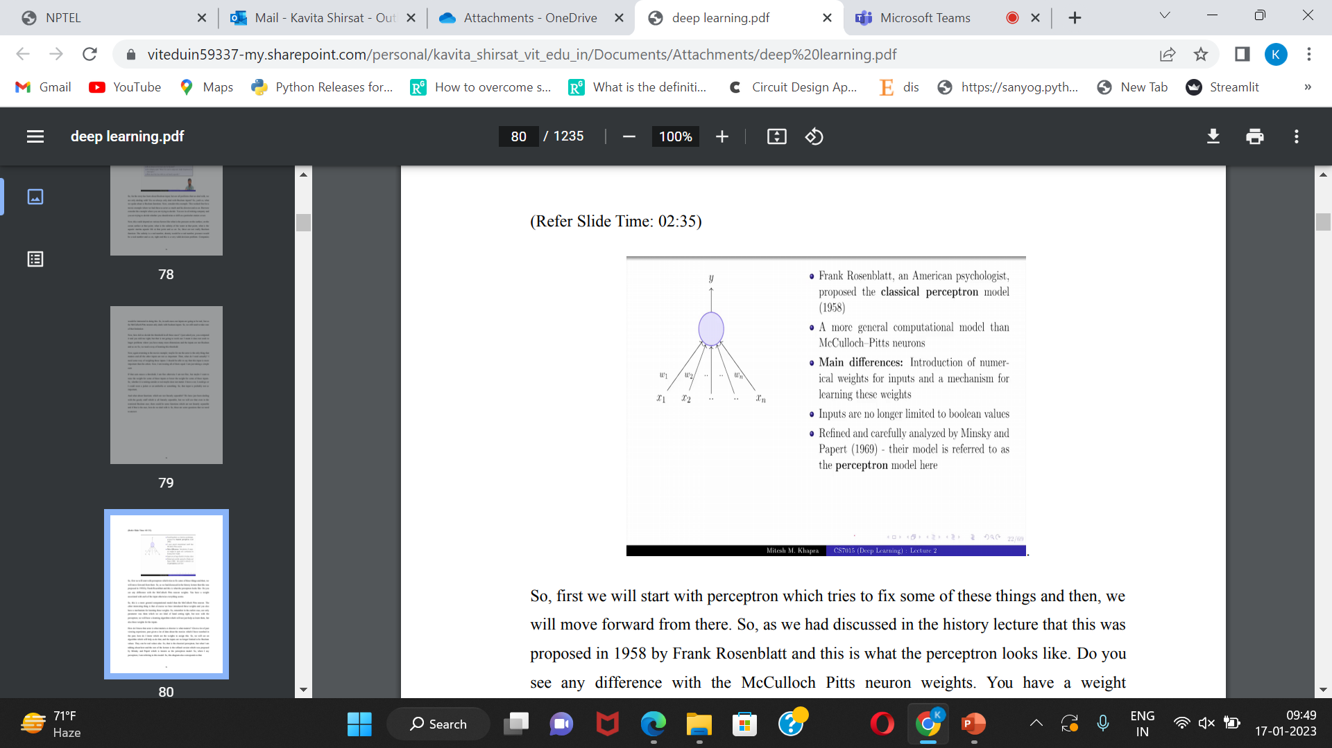
Perceptron

Slide 12
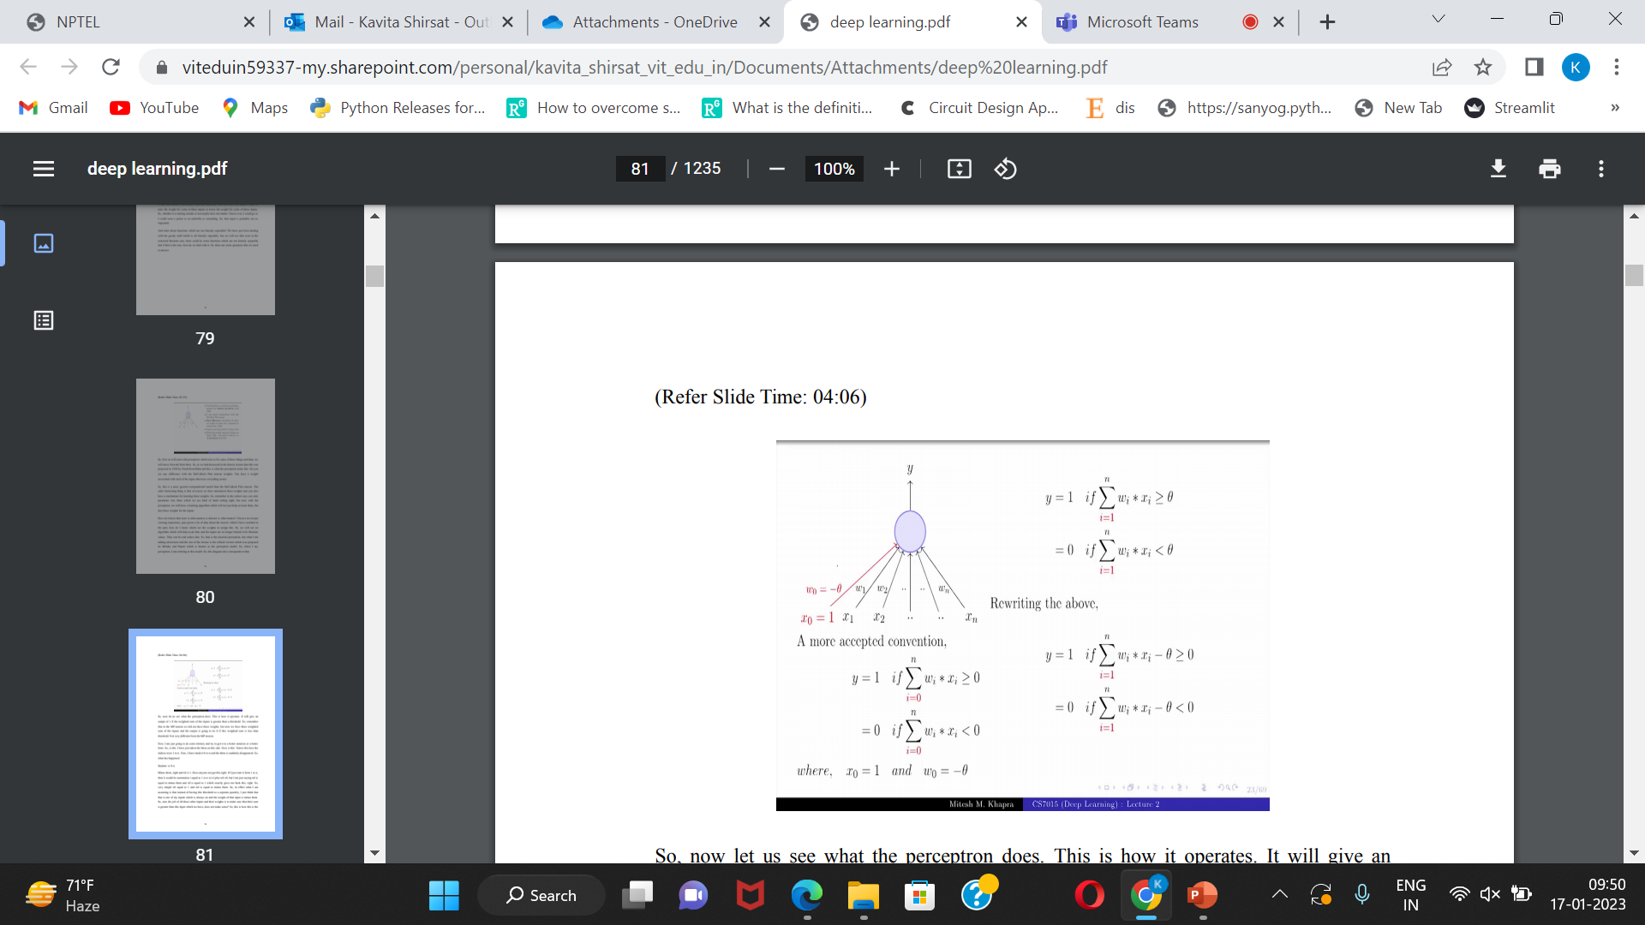
Perceptron

Slide 13
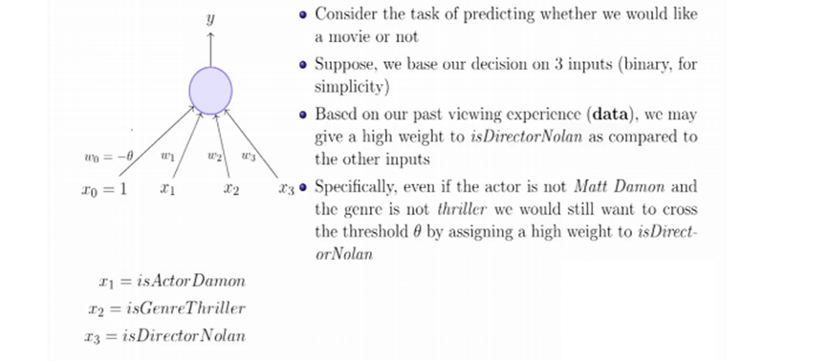

Perceptron

Slide 14
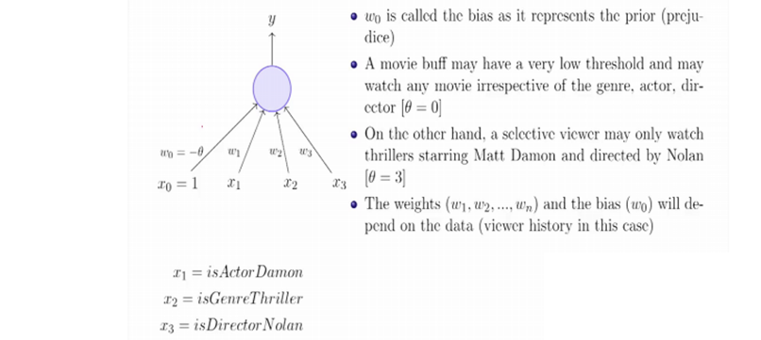
Perceptron

Slide 15
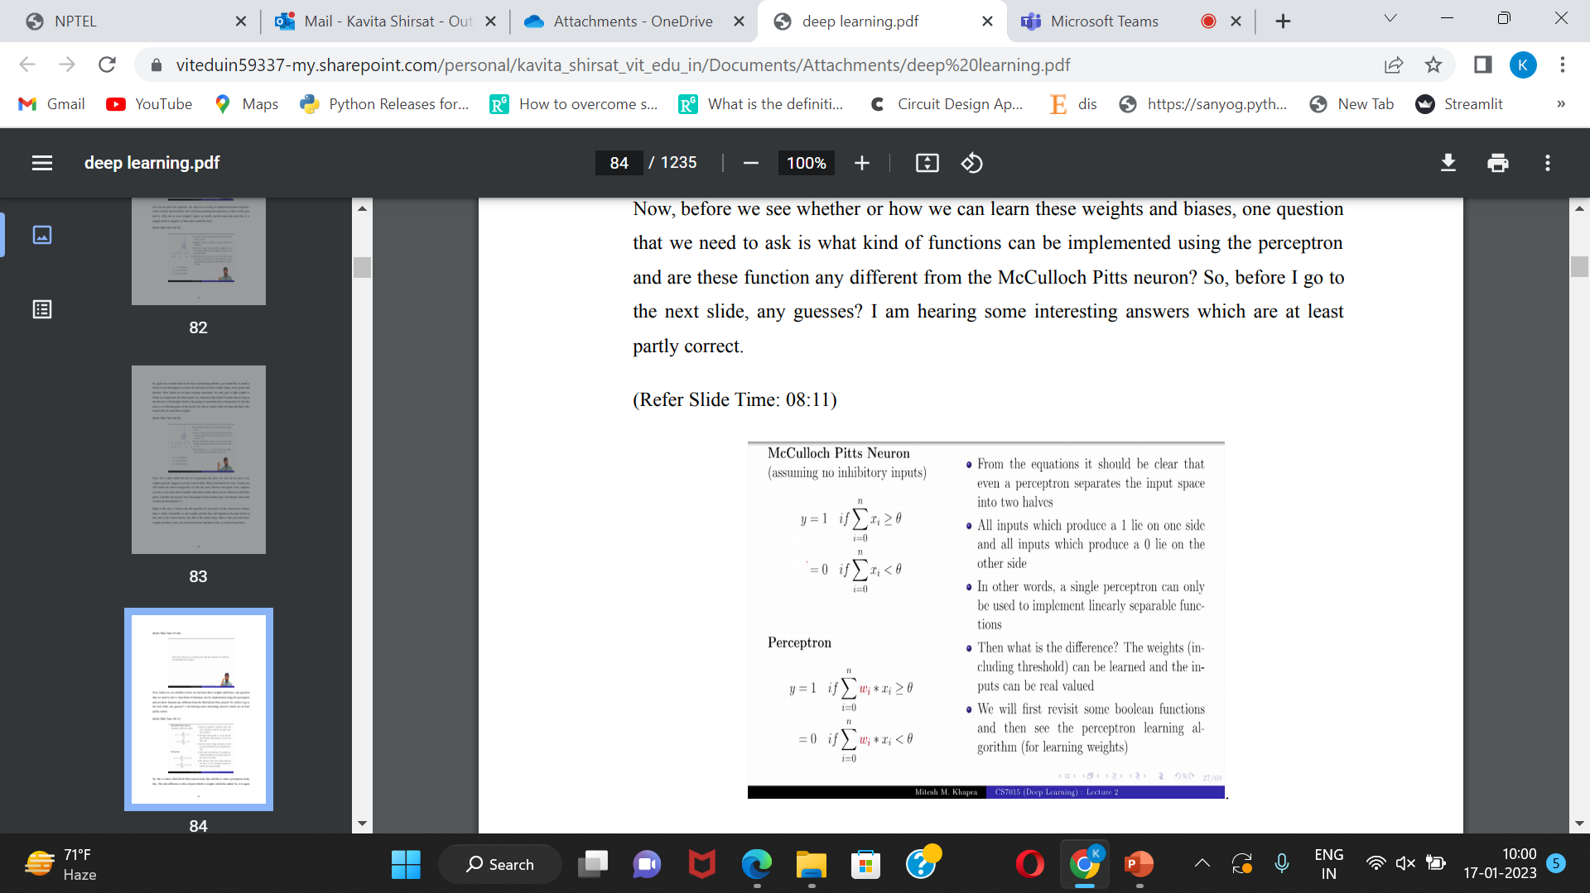
summary

Slide 16
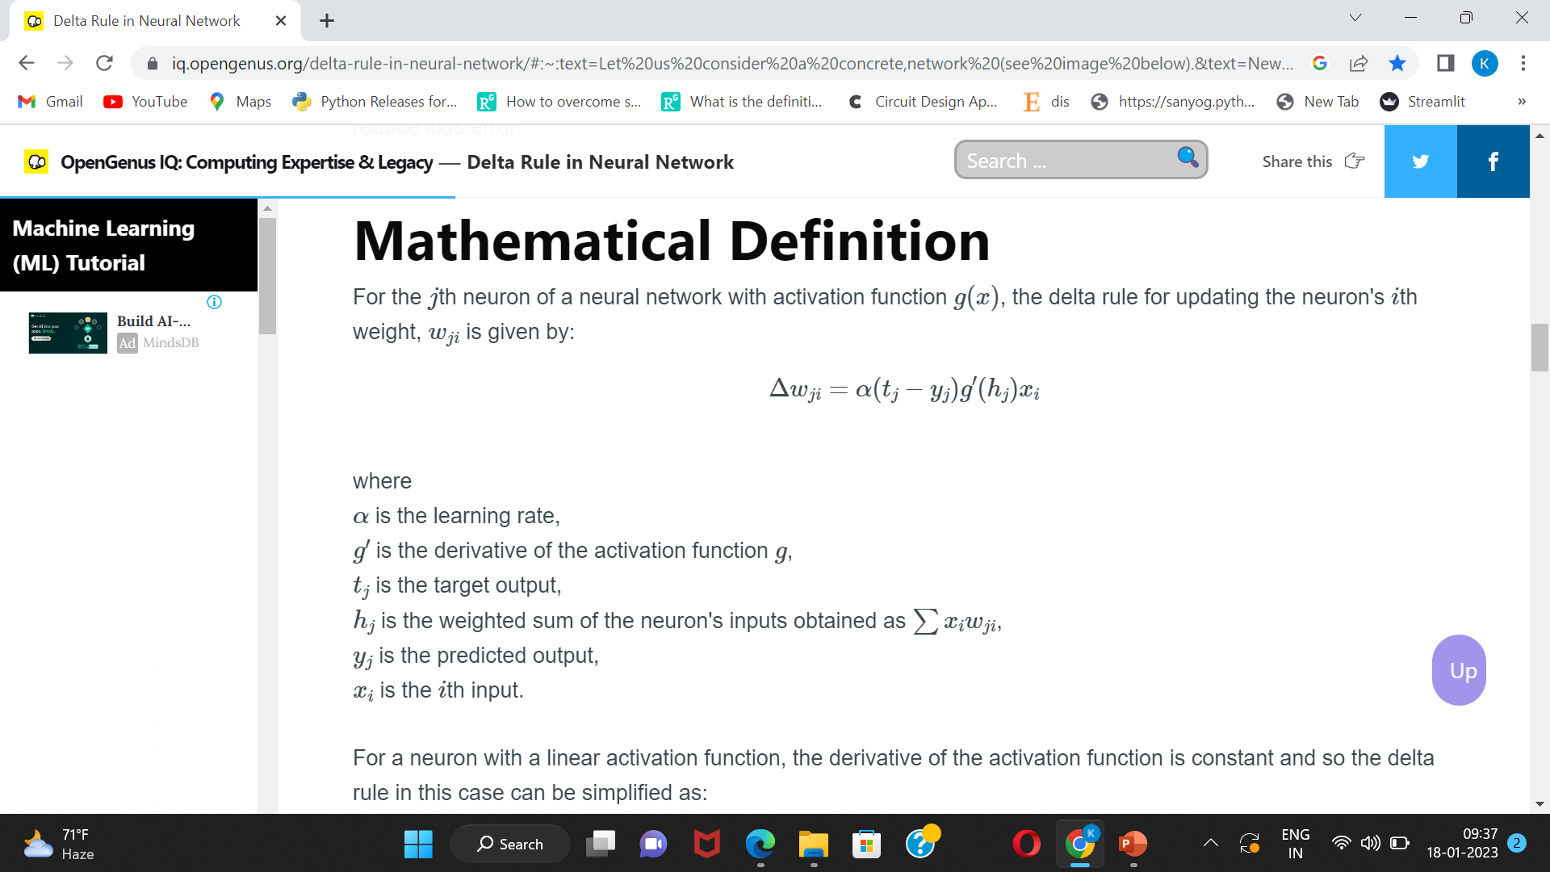
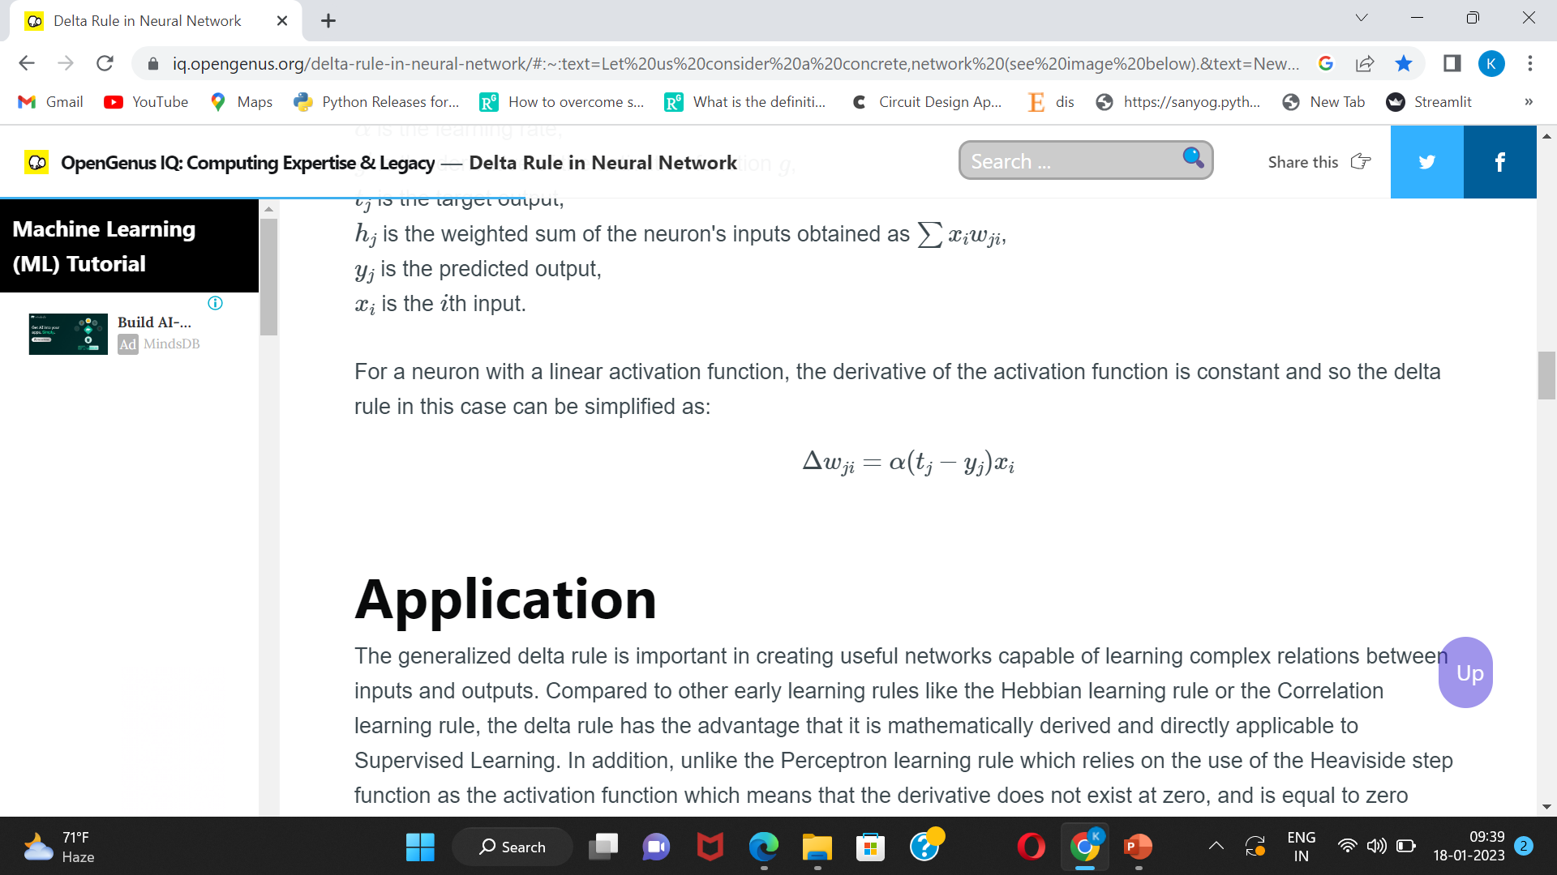
Delta rule
The delta rule is one algorithm that can be used repeatedly during training to modify the network weights to reduce loss error.
For a neuron with a linear activation function, the derivative of the activation function is constant and so the delta rule in this case can be simplified as:

Slide 17
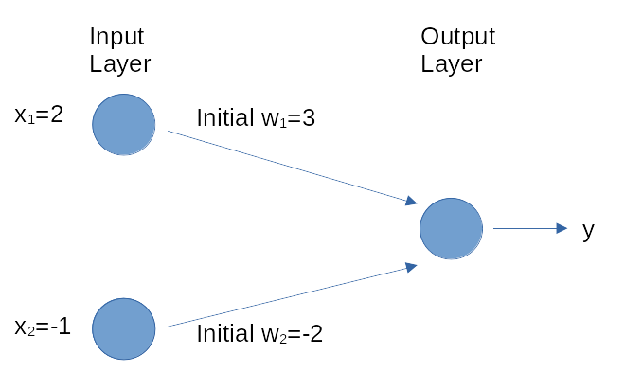
Example

Slide 18
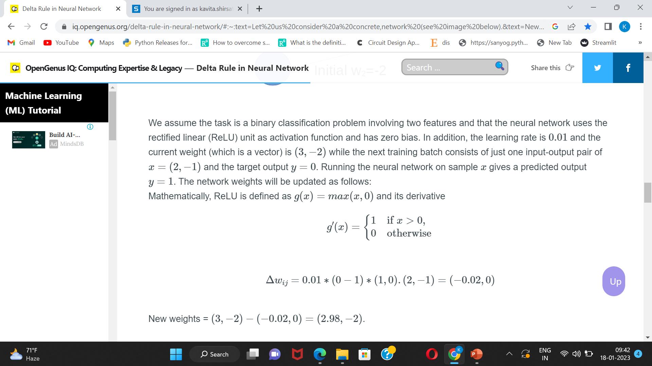

Slide 19
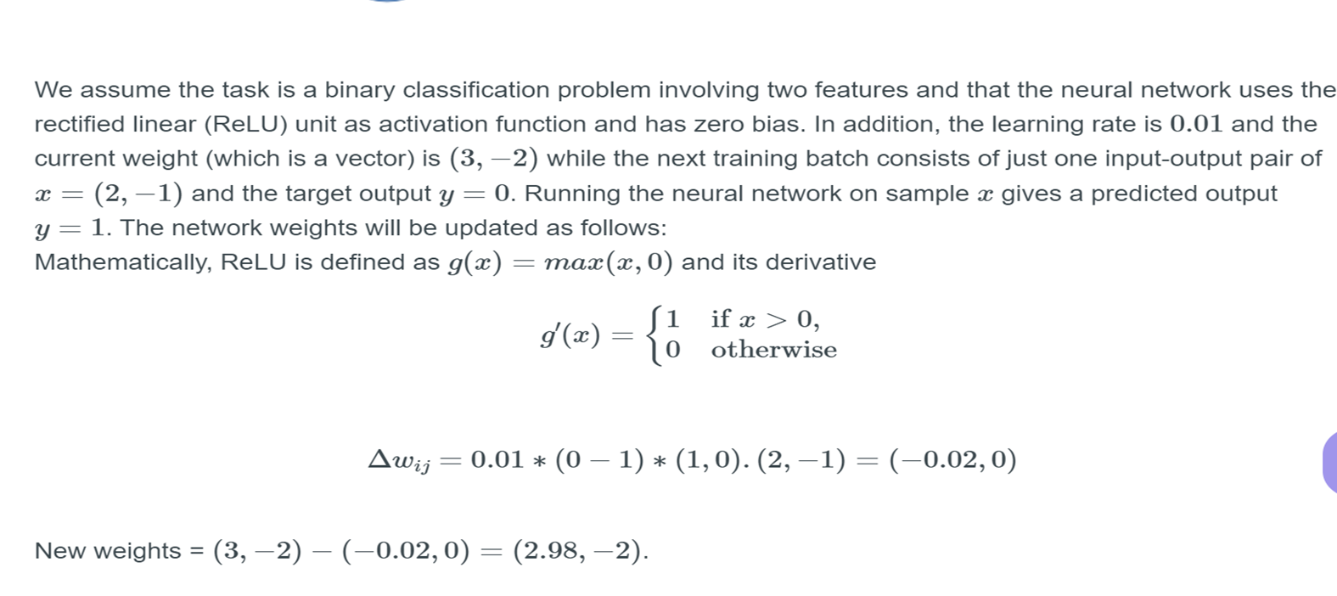

Slide 20
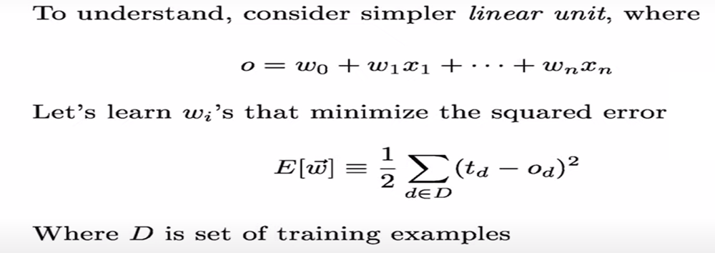
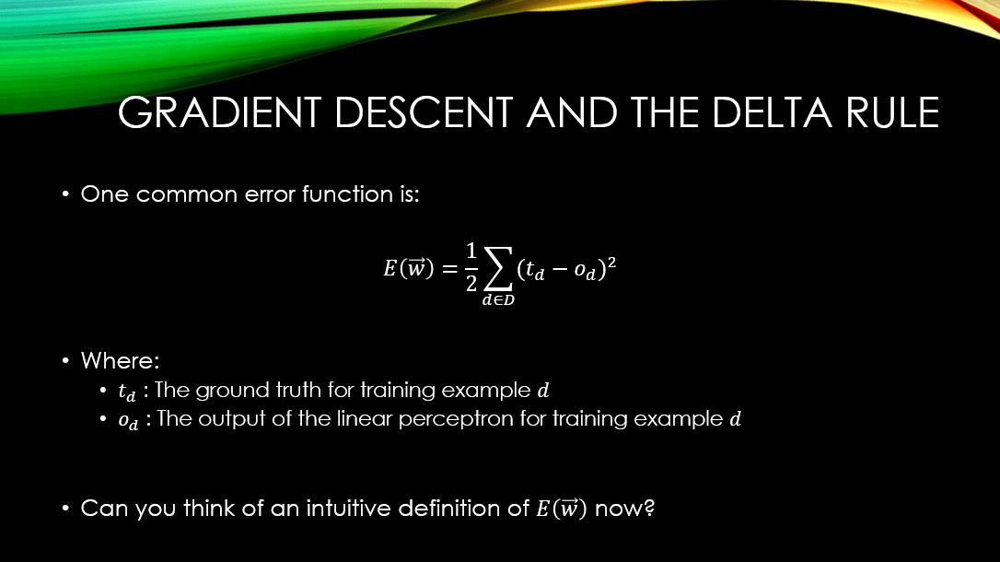
Error function
The Sum Squared Error (SSE) function that we will be using for our simple neural network

